Slide 1
Lecture 2
Classes & Structures
C++ Programming
Konstantin Leladze
FCS HSE 2022

Slide 2
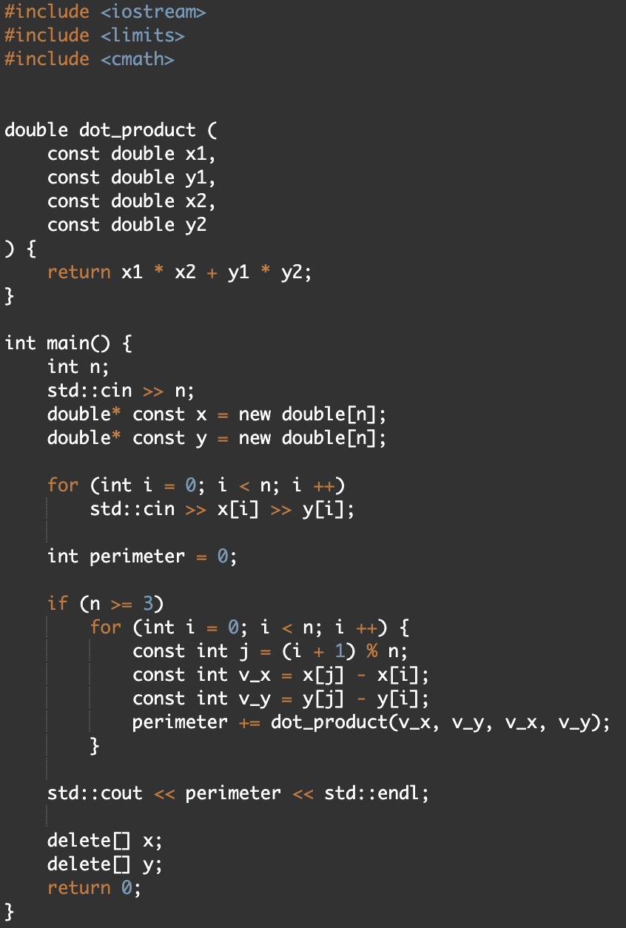
Structures, motivation
Let’s have a look on the solution of the problem about perimeter of convex polygon, which we have discussed in the previous lesson.
Problem:
We have to use two different arrays for storing x and y coordinate.
If we formulate this problem in such a way that it needs to be solved in 3D, then the number of arrays will increase to 3.
Maybe there is a tool thanks to which we could declare our own user-defined type and store these three variables of type double inside one single type?

Slide 3
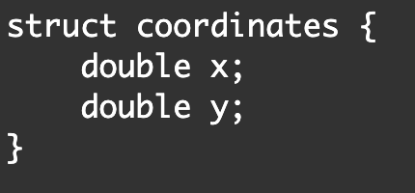
Structures, definition
The struct keyword allows us to define our own custom type, which can (and in our case will) contain variables.
The code shown in the screenshot on the right only defines the coordinates type, but does not create a variable of its type.
In-class declared variable is called a member field.
For example, in this struct we have 2 member fields: x and y.

Slide 4
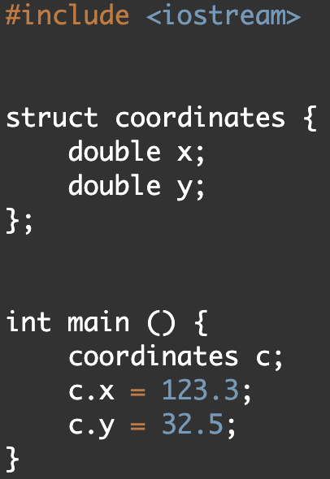
Instance VS Definition
To create a variable of our own specified type coordinates, we need to write the following code (see int main). Now, variable c is called instance of structure coordinates.
The number of instances of the coordinates structure is not limited. You can imagine a struct is a blueprint and its instances are products made from this blueprint.
The variables x and y are contained within the coordinates type. To access them (both read and write), you need to use a special operator . (will be discussed in the future).
Their lifetime is limited by the lifetime of an instance of structure coordinates: when it is destroyed, so are the variables it contains.

Slide 5
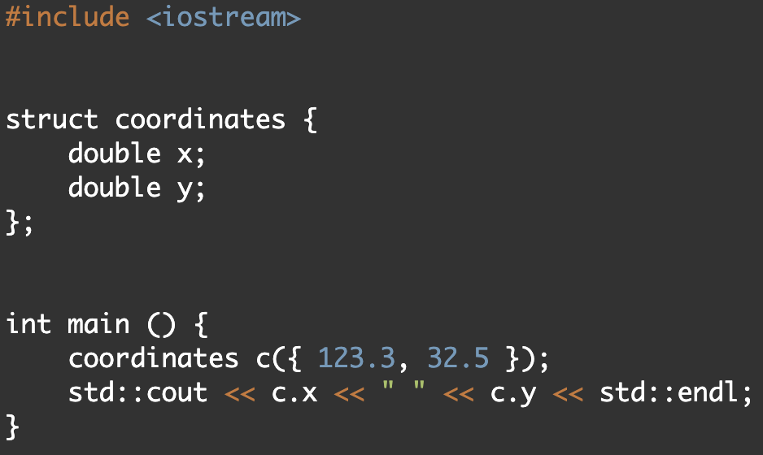
Constructor
Let's imagine that we have created a structure containing 10 internal types. Agree, writing 10 lines of code to initialize each variable inside is not the most pleasant job.
There is such a thing as a constructor. The constructor allows you to initialize all variables inside the structure instance with values. On the right, I gave an example of the direct-list-initialization constructor.

Slide 6
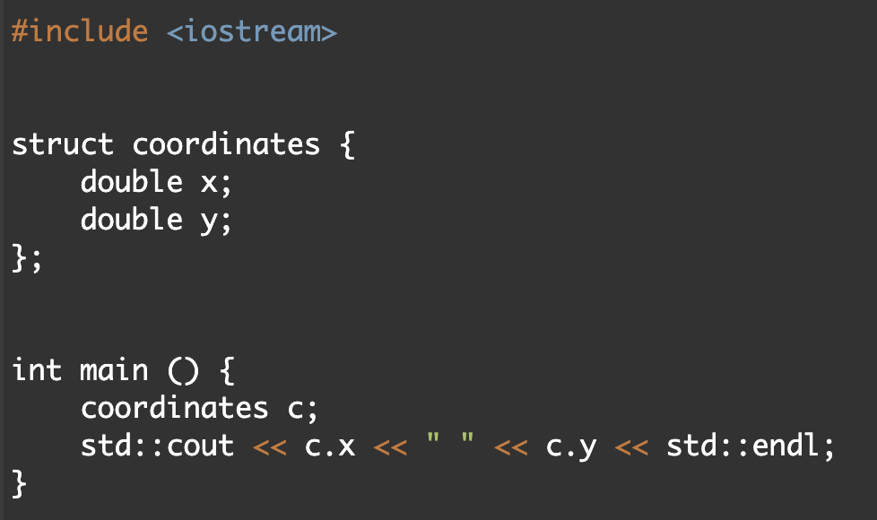
Default Constructor
In most cases (in which specifically we will discuss later), the structure has a default constructor which does not accept any arguments and initializes all fields by default.
For example, in the case of our structure, the default constructor will fill x and y with zeros (and not random values, how would it happen if we set these variables in the main function)

Slide 7
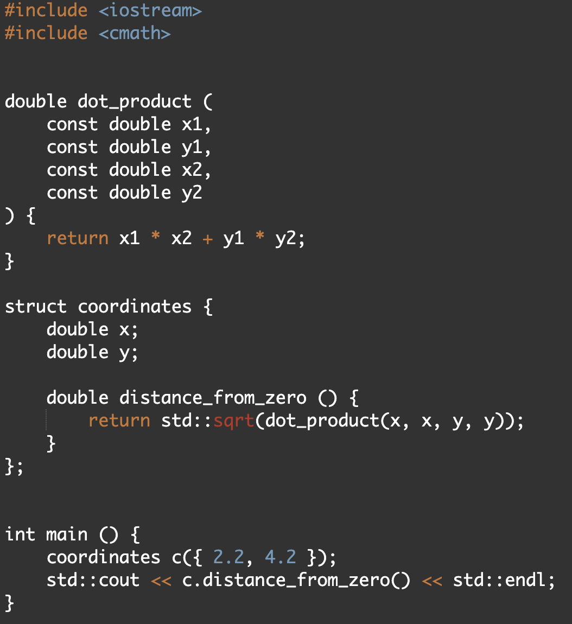
Methods
In addition to variables, we can define functions inside structures. A function defined inside structures is called a method.
In this case, all the variables contained in the instance of the structure will be available in the body of the function.
To call a method, we need to apply an operator . to some instance

Slide 8
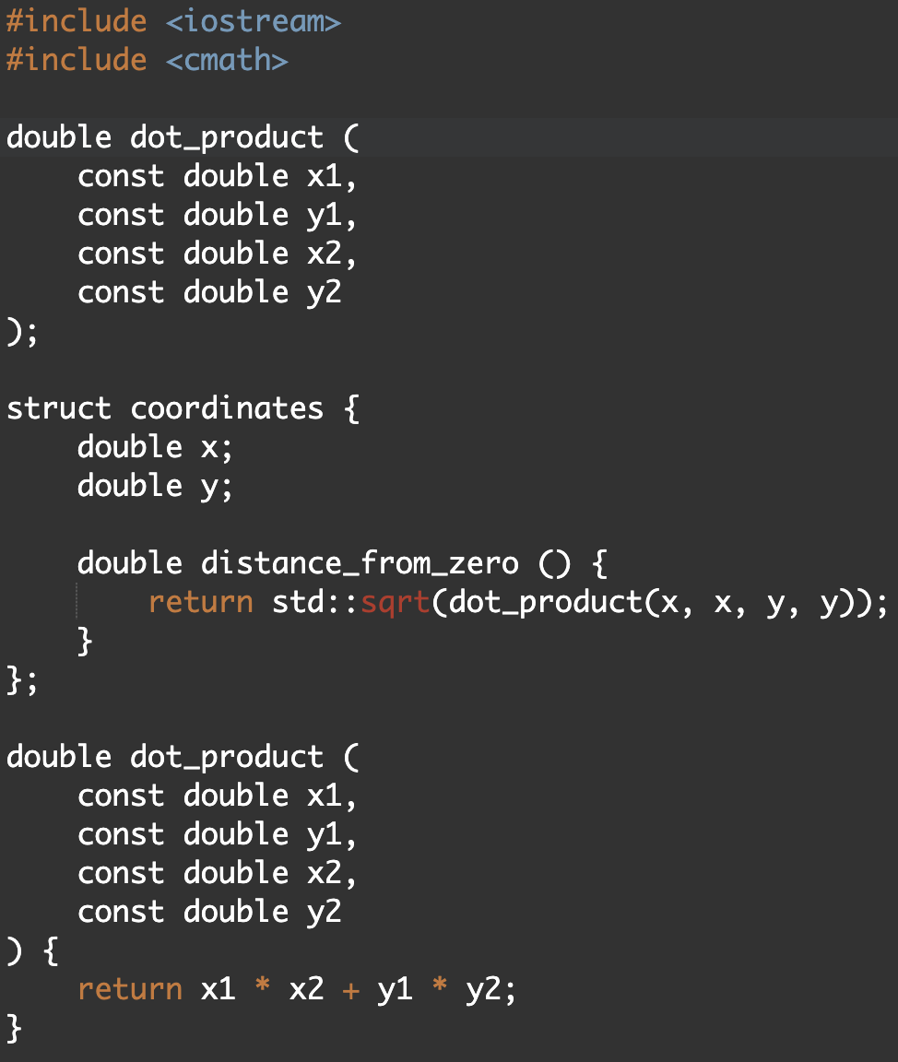
Static methods, motivation
In the previous example, we defined the dot_product function outside of the class. This is not very convenient, because in this case we need to keep in mind the fact that the coordinates struct is associated with the dot_product function. For example, if we want to transfer the definition of the class coordinates, we will need to transfer the definition of the dot_product function (or make a forward declaration)

Slide 9
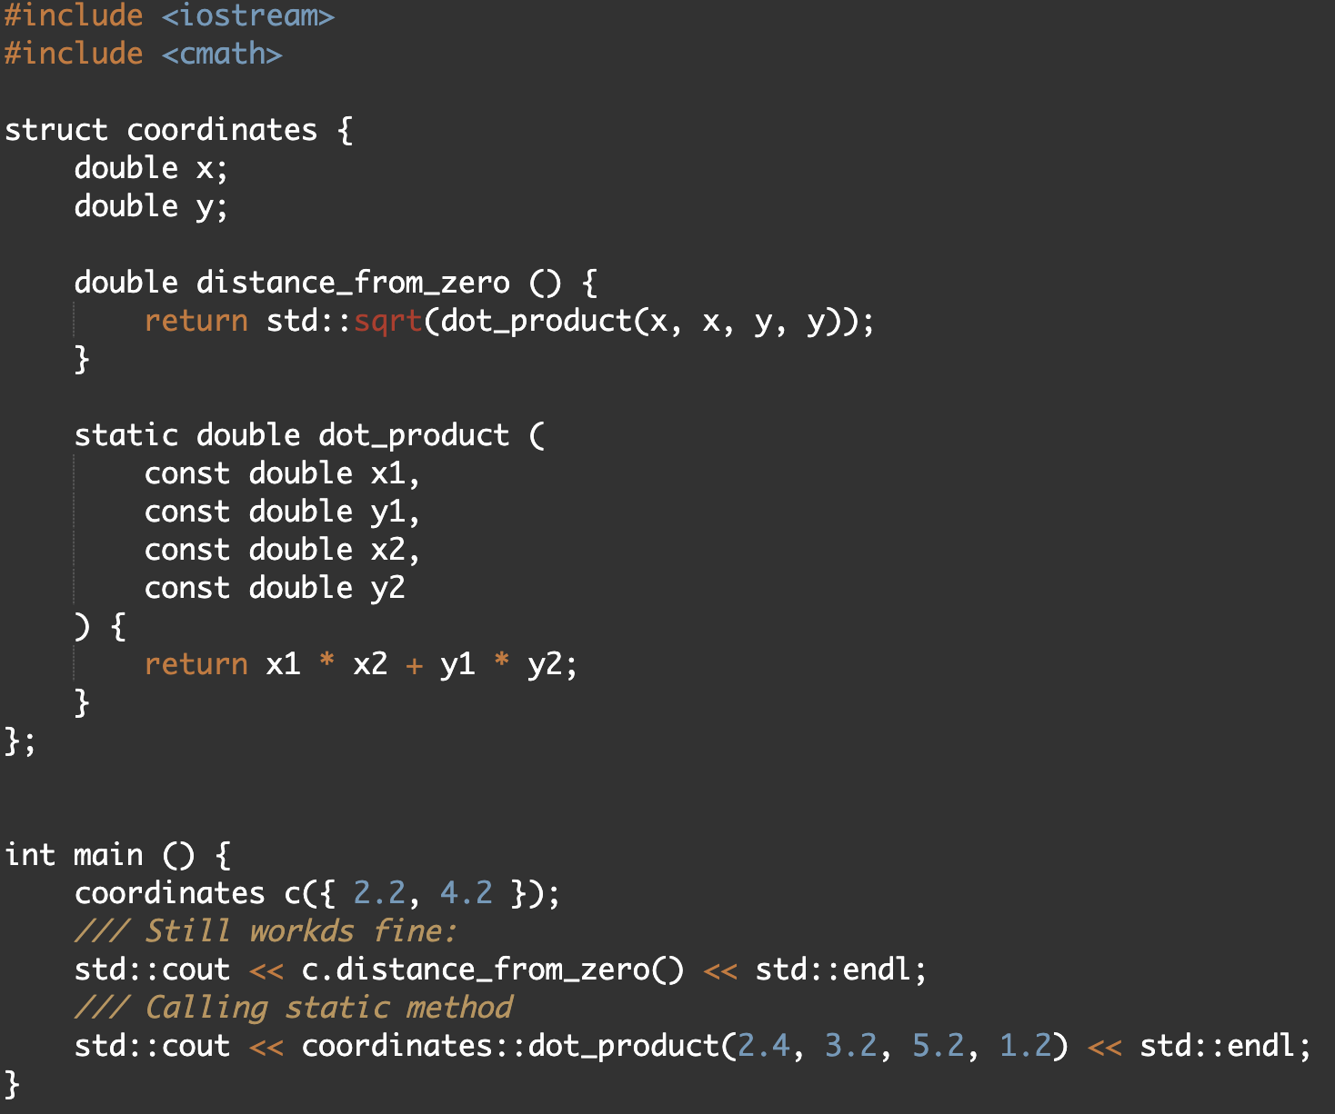
Static methods
To solve this problem, we can use a static method. The Static method is not associated with a specific instance of the structure, but with its type.
Because of this, inside a static method, we cannot access the variables defined inside the class, which, by the way, are called "fields".
You can call a static method from within a class simply by specifying its name.
To call it from outside, you need to apply the operator :: to the type of the struct (not to its instance!)

Slide 10
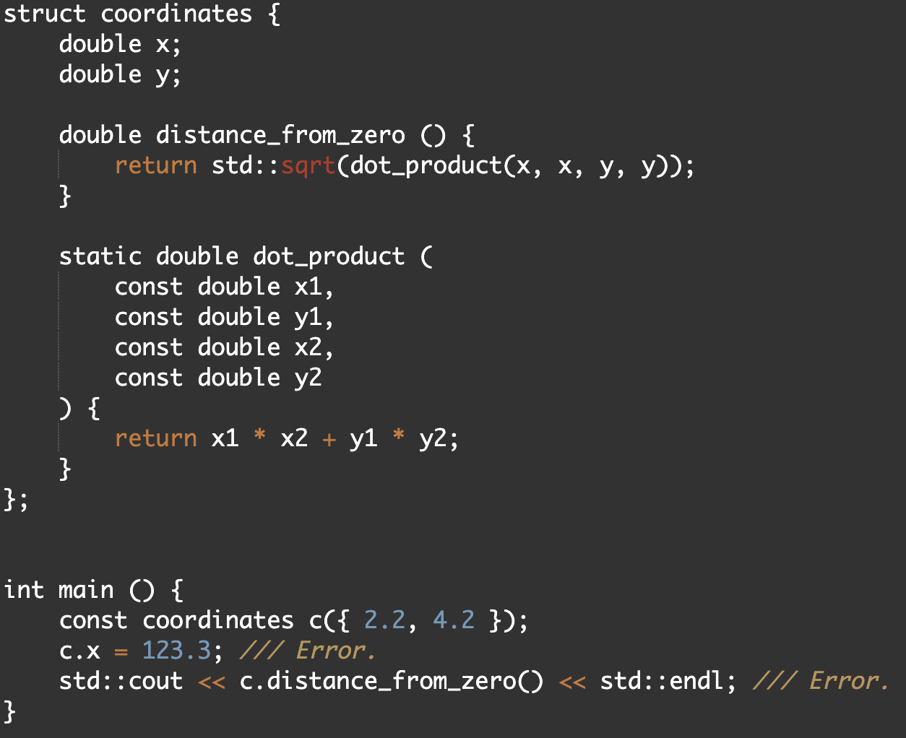
Const qualified instance
Struct instances can be const-qualified. In this case, we will not be able to change the internal variables of these structures and call non-const methods.
But what exactly is a non-const method? Non-const method is a method that is not defined as const!

Slide 11
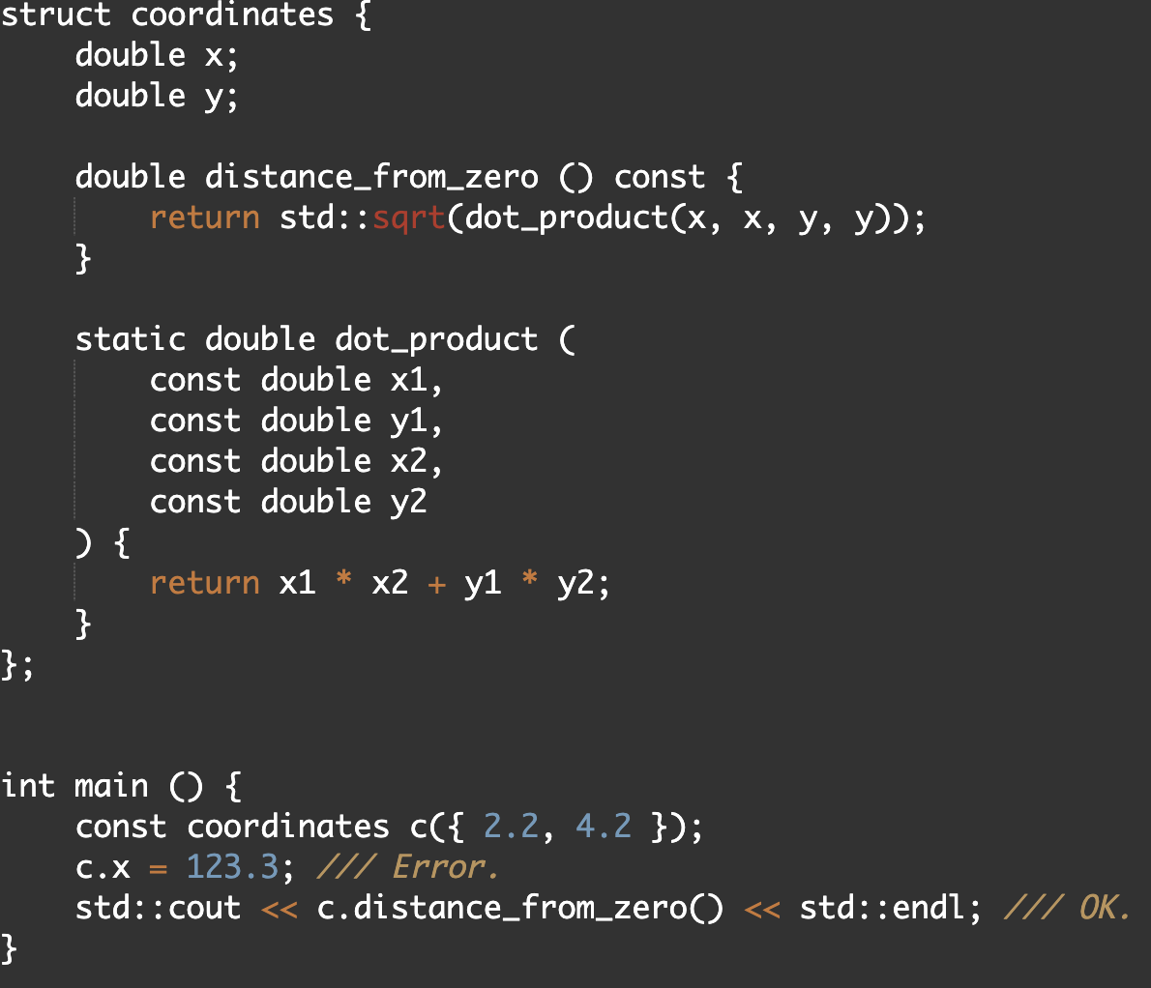
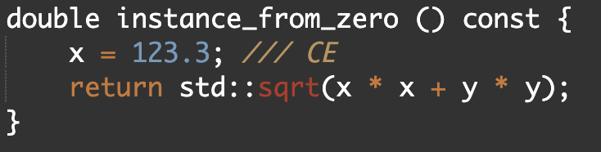
Const Methods
A const method is a method that can be called on a const-qualified instance, but it can NOT modify the internal fields of a structure:

Slide 12
Structures in std
C ++ cannot be imagined without the ability to define your own custom types. In fact, the language itself already has many built-in structure types.
For example:
std::vector
std::cin
std::cout
std::array
std::string
std::allocator
and many, many more…
In fact, most of these types are defined using the class keyword. To understand what its meaning is, let's look at such a thing as encapsulation.

Slide 13
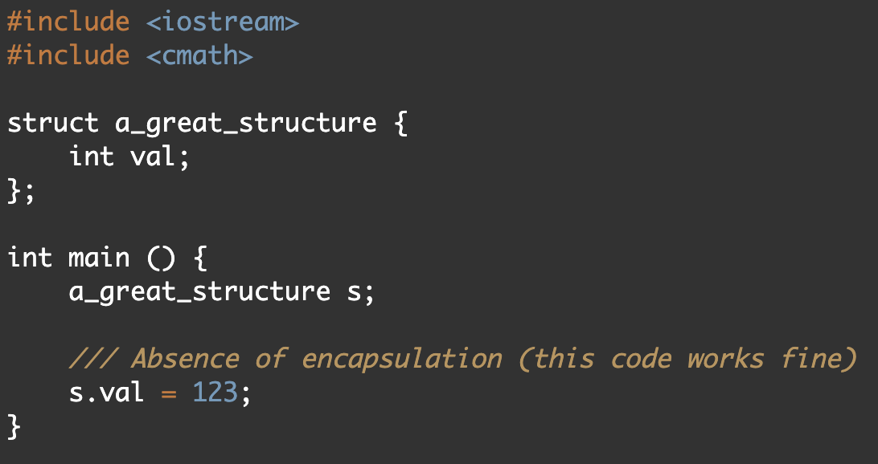
Encapsulation
In object-oriented programming (OOP), encapsulation refers to the bundling of data with the methods that operate on that data, or the restricting of direct access to some of an object's components.
Encapsulation is used to hide the values or state of a structured data object inside a class, preventing direct access to them by clients in a way that could expose hidden implementation details or violate state invariance maintained by the methods.

Slide 14
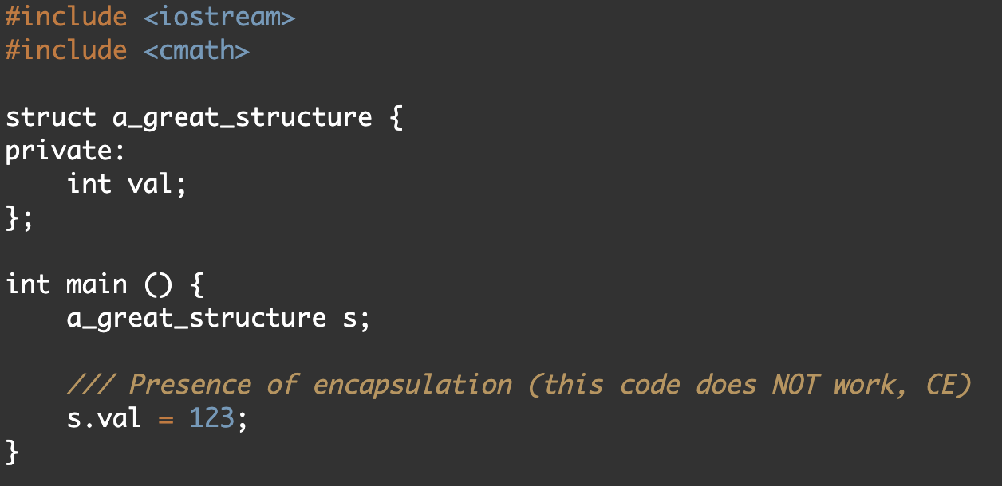
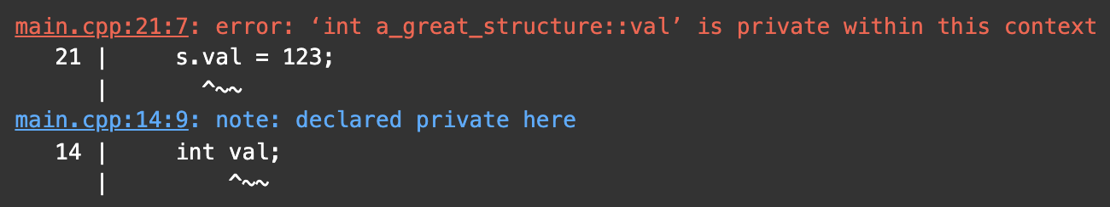
Private and public keywords
The special word private allows us to hide the fields of the structure from an external user, prohibit access to them.
The public keyword is the opposite of private. By default, all fields of the structure are set to public.

Slide 15
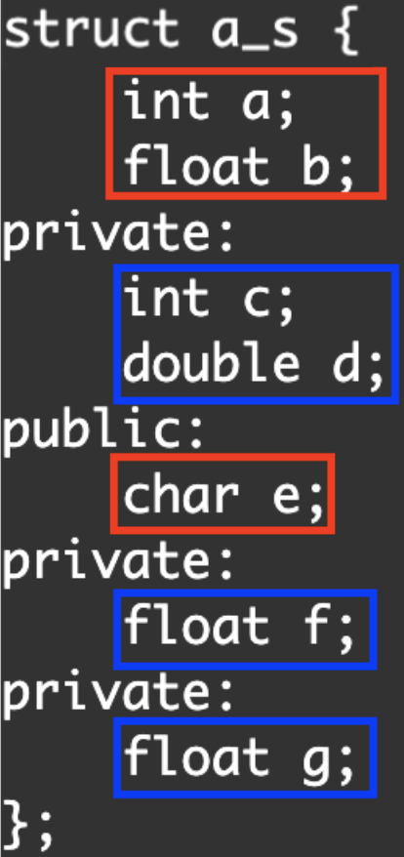
Sections
When we use a private or public keyword, we create the corresponding section in the class or struct.
All fields and methods specified after the beginning of a section (after specifying the word private or public), but before the beginning of the next section, refer to it.
In the screenshot, private variables are boxed in blue, public - in red.

Slide 16
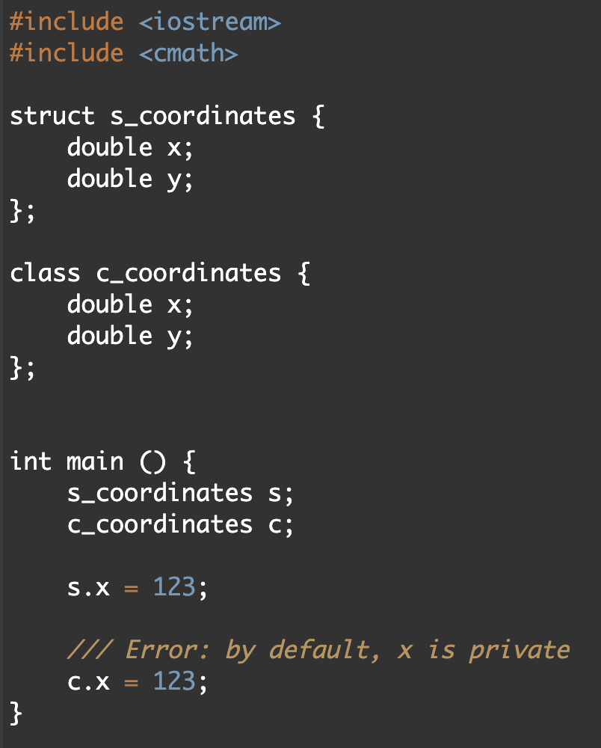
struct vs class
There are 2 differences in total between class and struct. These differences are:
1)
By default, section of struct is public
By default, section of class is private
2) We will discuss the second difference later.
Since there is little difference between class and structure, you can use both words. However, it is common practice to use the word struct only when you are not specifying private fields (not using encapsulation). If your type uses encapsulation, it is better to define it as a class.

Slide 17
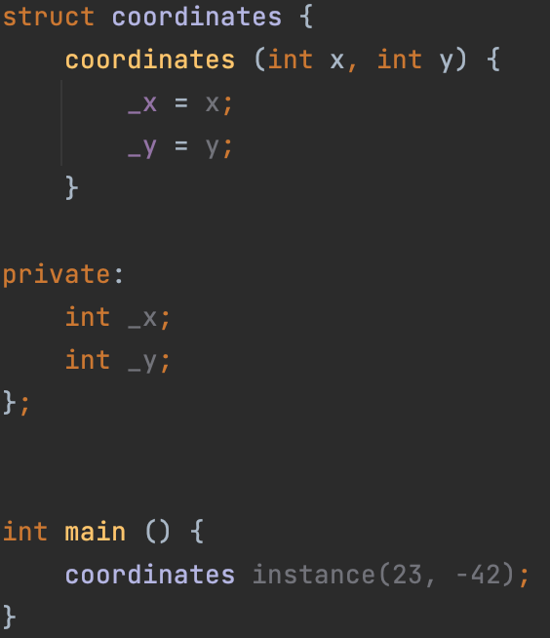
Constructor
Constructor is a special non-static member function (aka method) of a class that is used to initialize objects (aka instances) of its class type.
Defining custom constructor:
Defining your own constructor for a class is very similar to defining a method, however, instead of the method name, we write the name of the class itself, and do not specify the return value (constructors do not return anything!)
As you can see, in the main function, we passed values ​​to the constructor, and now an object named instance has 23 and -42 in the _x and _y fields, respectively.
Notes:
1) Несмотря на то, что у конструктора нет return-value-type, слово return все же можно использовать в нем (но без указания значения!).
2) Обязательно упомянуть про кодстайл: добавляем “_”, если переменная в привате (смотри поля _x и _y)

Slide 18
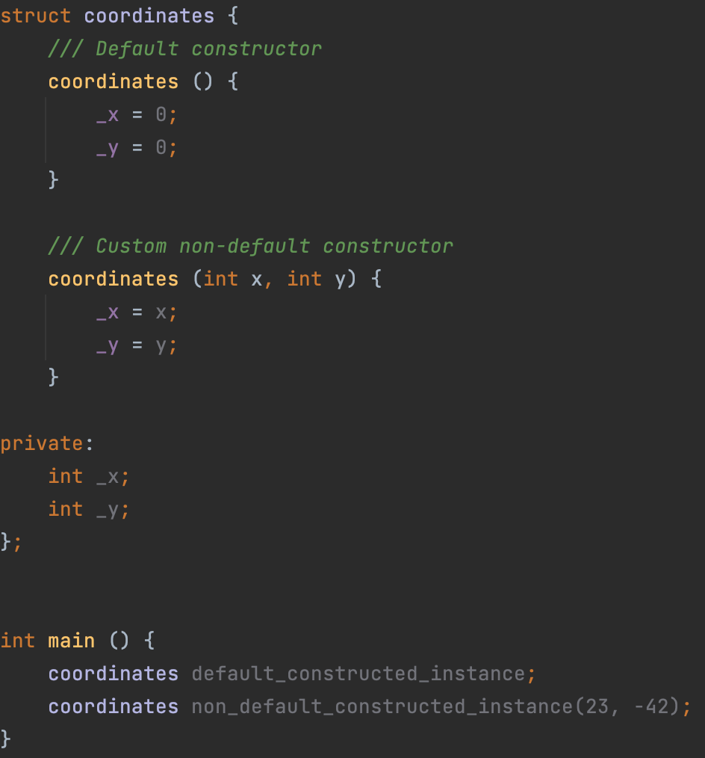
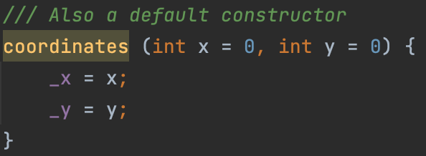
Default constructor
A default constructor is a constructor which can be called with no arguments (either defined with an empty parameter list, or with default arguments provided for every parameter). A type with a public default constructor is called DefaultConstructible.
You should not write parentheses when creating an instance to call the default constructor.
A constructor, all arguments of which have default values, is also a default constructor (because formally, it can be called without passing values ​​from the outside!):

Slide 19
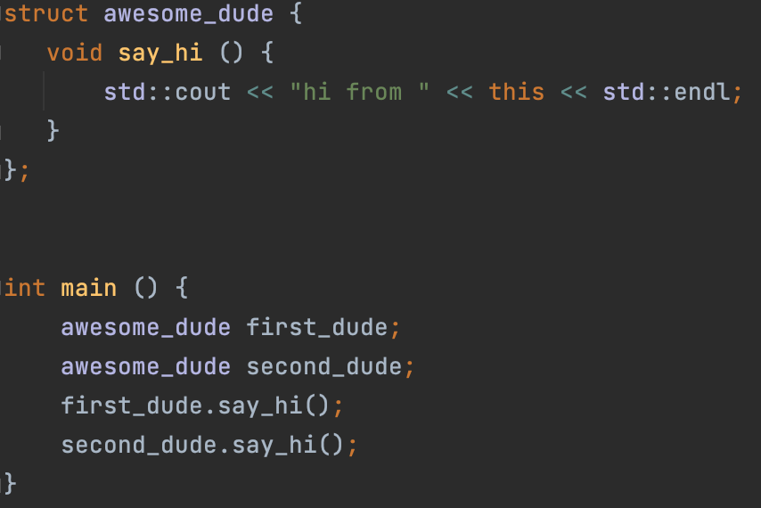
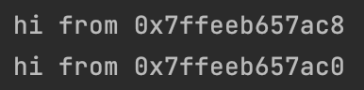
Keyword this
The keyword this stores an address of the object (aka instance) on which the non-static member function is being called.

Slide 20
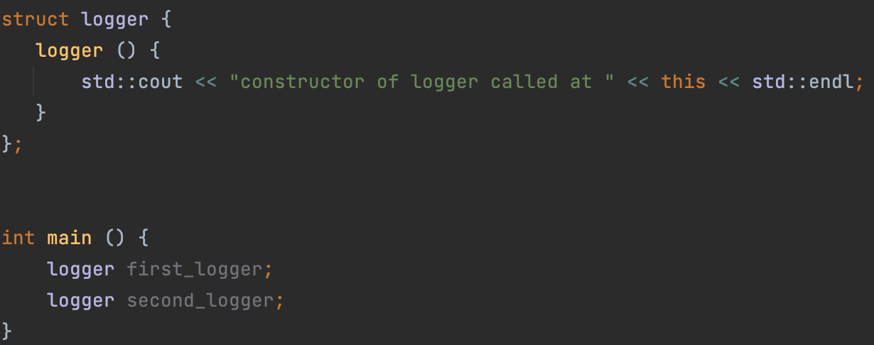
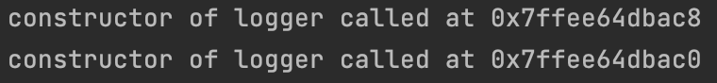
Another example with keyword this: class logger
The this keyword is also available in the constructor, so we can write something like this:

Slide 21
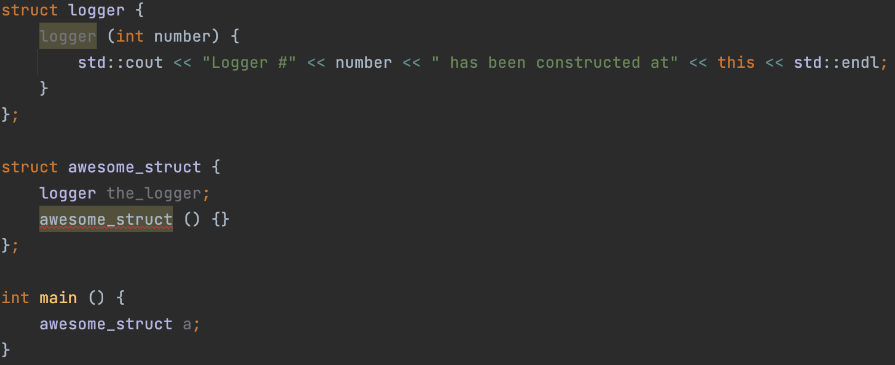
Instance as a field
A class or structure can contain an instance as a field inside itself. But in this case, if the instance does not have a default constructor, then it is not clear how to call the constructor of this instance.

Slide 22
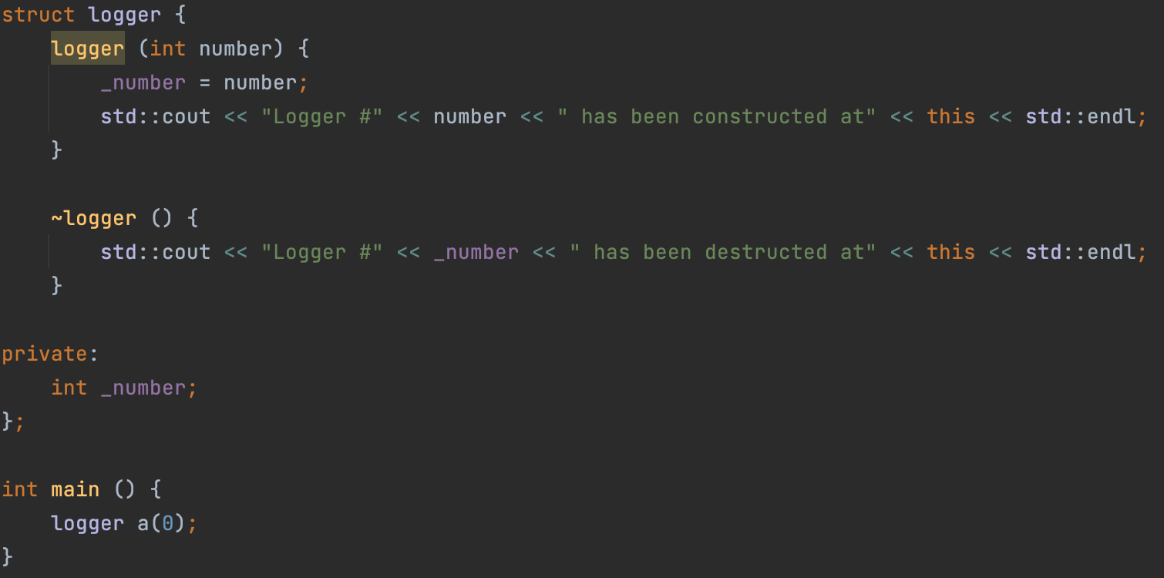
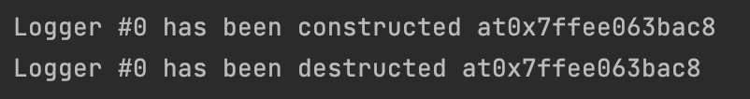
Destructor
A destructor is a special member function that is called when the lifetime of an object ends. The purpose of the destructor is to free the resources that the object may have acquired during its lifetime.

Slide 23
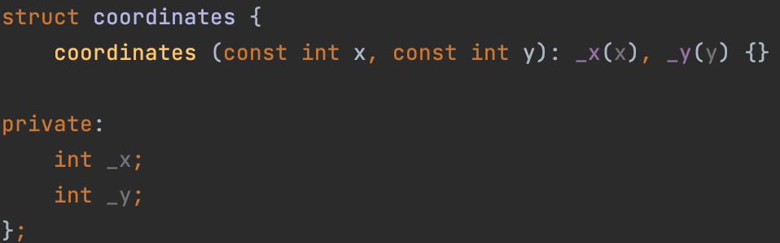
Member initializer lists
Member initializer list allows you to initialize members in the order of their declarations in the class before executing the constructor body. Member initializer list is part of the definition (not declaration).
In addition, member initializer lists help us solve the problem with member-instance initialization.
An example of a solution to the problem is shown on the next slide.

Slide 24
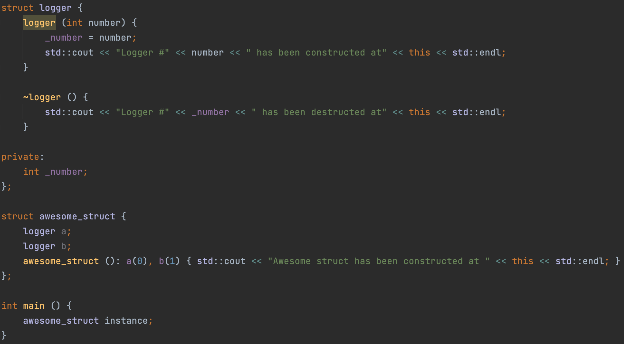
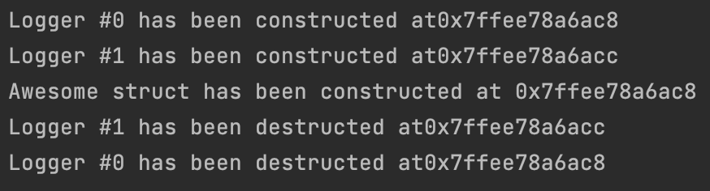
Member initializer lists: order of initialization
The order of member initializers in the list is irrelevant: the actual order of initialization is as follows:
1) Non-static data member are initialized in order of declaration in the class definition.
2) The body of the constructor is executed
Notes:
Тут обязательно сказать про то, что a(0) – это вызов конструктора logger’а с параметром 0
Обязательно, обратить внимание на то, что порядок вызова конструкторов logger’а определяется НЕ порядком, заданным member initializer list’ом, а порядком, заданным телом класса. Пояснить причину этого: if initialization order was controlled by the appearance in the member initializer lists of different constructors, then the destructor wouldn't be able to ensure that the order of destruction is the reverse of the order of construction
Обратить внимание на порядок вызова деструктора (это комментарий к пункту 2)

Slide 25
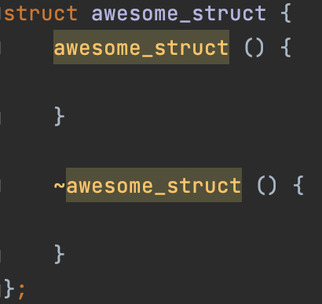
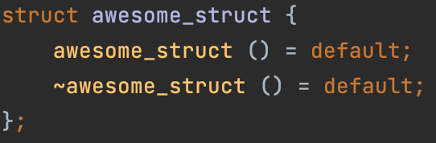
Defaulted default constructor and destructor
Explicitly defaulted function declaration is a new form of function declaration that is introduced into the C++11 standard. You can append the = default; specifier to the end of a function declaration to declare that function as an explicitly defaulted function. The compiler generates the default implementations for explicitly defaulted functions, which are more efficient than manually programmed function implementations. A function that is explicitly defaulted must be a special member function and has no default arguments. Explicitly defaulted functions can save your effort of defining those functions manually.

Slide 26
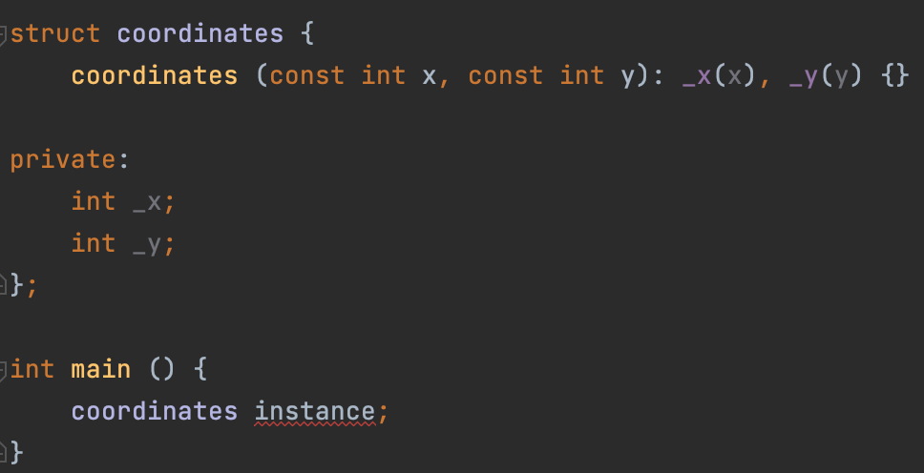
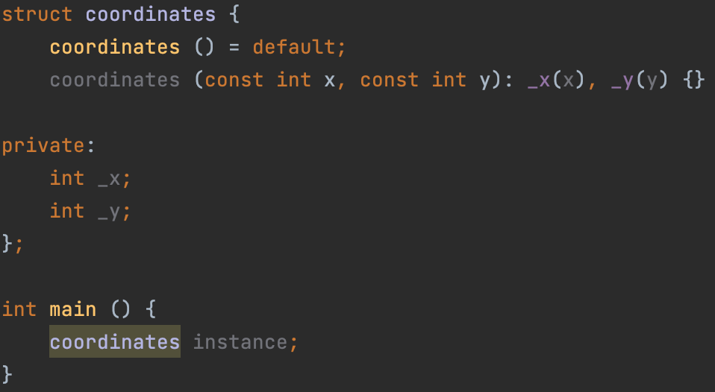
Defaulted default constructor and destructor
In the last lecture, I said that in some cases the compiler will generate default constructos on its own. In fact, this does not always happen. For example, if you declare a custom constructor for your class, the default constructor will no longer be generated for it. We'll talk about this in detail on the next slides, but now let's see an example of the code.
This is how we can train the C ++ compiler to generate the defaulted default constructor even if it was not automatically generated.
Notes:
Пояснить, что в этом примере это бы привело к неточности: поля _x и _y не проинициализирубтся defaulted default constructor’ом

Slide 27
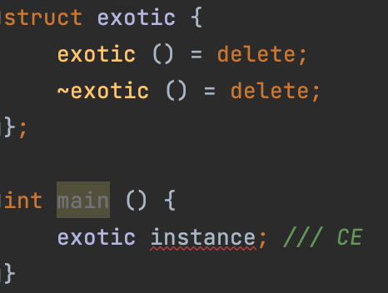
Deleted default constructor and destructor
The default constructor and destructor can also be removed. To do this, use the syntax = delete; This can be useful in some exotic cases, such as when you want to create a class that should not be instantiated.

Slide 28
Implicitly declared and defined default constructor
Implicitly declared default constructor:
If no user-declared constructors of any kind are provided for a class type (struct or a class), the compiler will always declare a default constructor as a public member of its class.
Implicitly defined default constructor:
If the implicitly-declared default constructor is not defined as deleted, it is defined (that is, a function body is generated and compiled) by the compiler if, and it has the same effect as a user-defined constructor with empty body and empty initializer list. That is, it calls the default constructors of the non-static members of this class.
The implicitly-declared or defaulted default constructor for class T is defined as deleted if any of the following is true:
T has a member of reference type without a default initializer.
T has a non-const-default-constructible const-member without a default member initializer.
T has a member which has a deleted default constructor, or its default constructor is ambiguous or inaccessible from this constructor.
Notes:
1) Объяснить, почему на этом слайде именно 2 подзаголовка: Declaration и Definition. Пояснить, что факт генерации declaration’а default-constructor’а компилятором НЕ влечет за собой факт генерации definition’a default-constructor’а.
2) Упомянуть, что все три пункта из последнего списка будут разобраны на следующем слайде

Slide 29
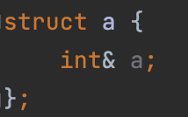
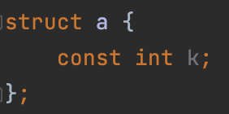
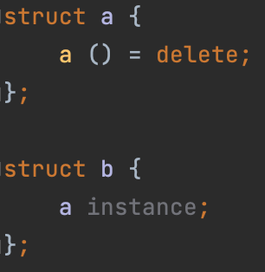
Implicitly declared and defined default constructor
T has a member of reference type without a default initializer.
T has a non-const-default-constructible const-member without a default member initializer.
T has a member which has a deleted default constructor, or its default constructor is ambiguous or inaccessible from this constructor.
Notes:
1) Объяснить, почему на этом слайде именно 2 подзаголовка: Declaration и Definition. Пояснить, что факт генерации declaration’а default-constructor’а компилятором НЕ влечет за собой факт генерации definition’a default-constructor’а.
2) “is not defined as deleted” – тут прерваться на секунду и сказать, что об этом совсем скоро поговорим

Slide 30
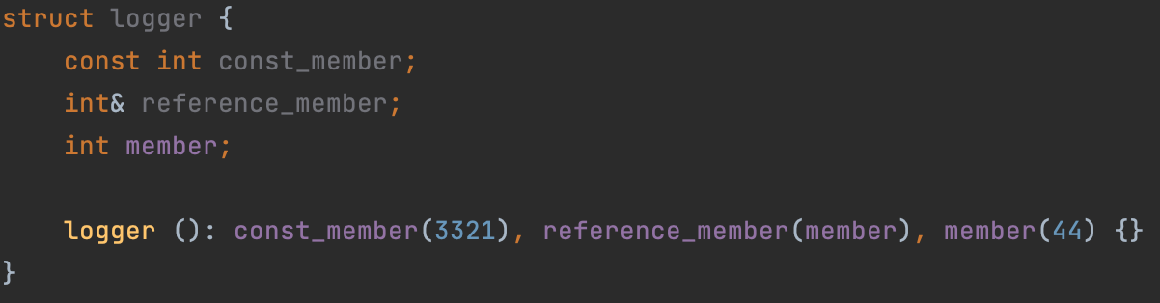
Member initializer lists again
Let’s solve the problem with initializing const-members and reference members using member initializer lists
Notes:
1) Объяснить, почему на этом слайде именно 2 подзаголовка: Declaration и Definition. Пояснить, что факт генерации declaration’а default-constructor’а компилятором НЕ влечет за собой факт генерации definition’a default-constructor’а.
2) “is not defined as deleted” – тут прерваться на секунду и сказать, что об этом совсем скоро поговорим

Slide 31
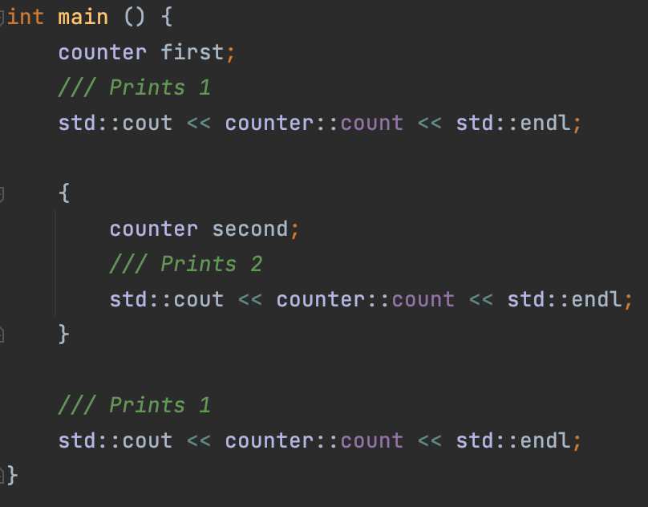
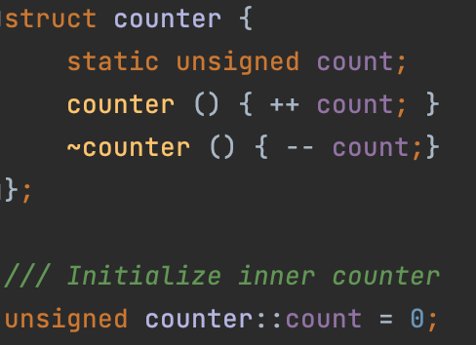
Static member field
Member field can be static. In this case, it will be associated with the class type itself, and not with the class instance. Consider a standard example: a class that contains a counter that allows you to find out how many objects of this class are currently instantiated.

Slide 32
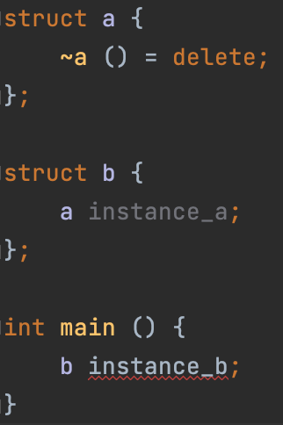

Implicitly declared and defined destructor
Implicitly declared destructor:
If no user-declared prospective destructor is provided for a class type (struct, class), the compiler will always declare a destructor as an inline public member of its class.
Deleted implicitly declared destructor:
The implicitly-declared or defaulted destructor for class T is defined as deleted if any of the following is true:
T has a non-static data member that cannot be destructed (has deleted or inaccessible destructor)
Implicitly defined destructor:
If an implicitly-declared destructor is not deleted, it is implicitly defined (that is, a function body is generated and compiled) by the compiler. This implicitly-defined destructor has an empty body.

Slide 33
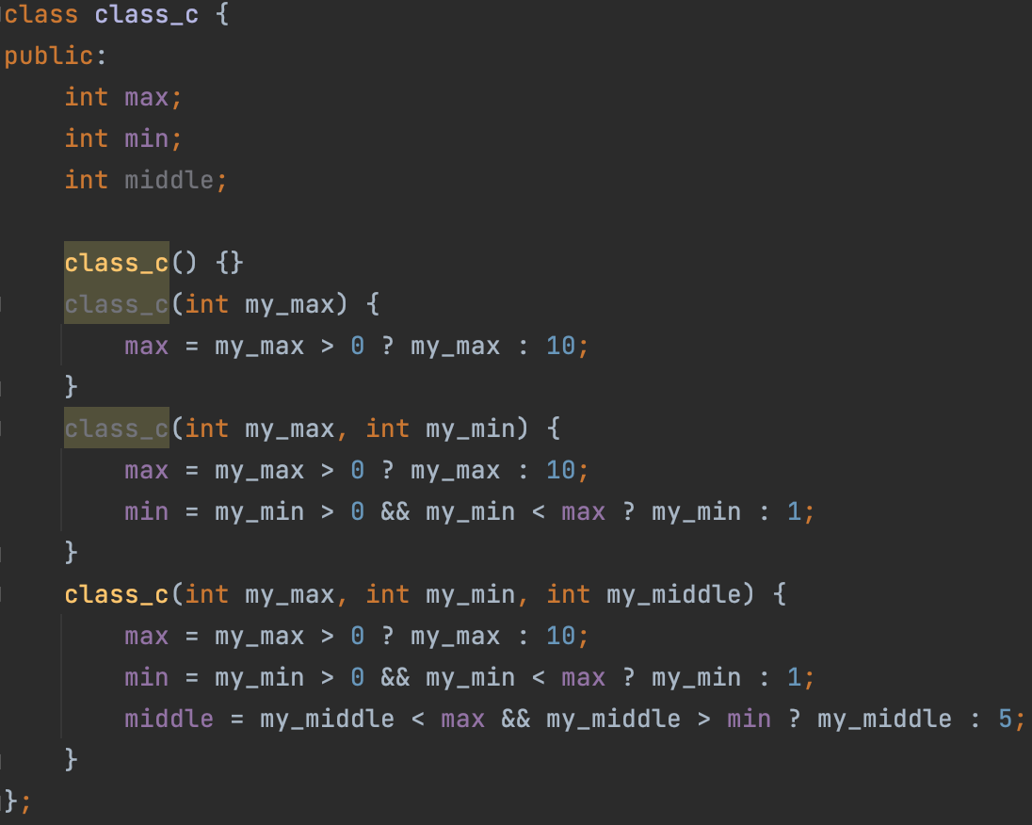
Delegating constructors
Many classes have multiple constructors that do similar things—for example, validate parameters:

Slide 34
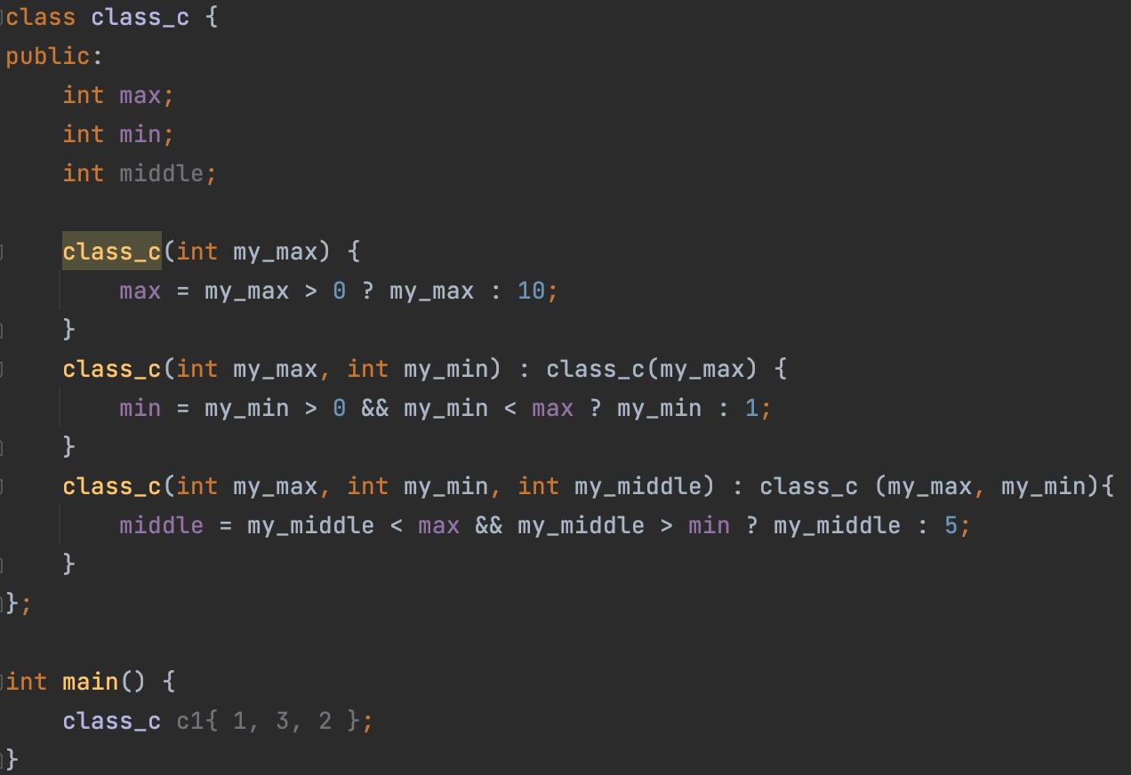
Delegating constructors
You could reduce the repetitive code by adding a function that does all of the validation, but the code for class_c would be easier to understand and maintain if one constructor could delegate some of the work to another one.
To add delegating constructors, use the constructor (. . .) : constructor (. . .) syntax:
Notice that the constructor class_c(int, int, int) first calls the constructor class_c(int, int), which in turn calls class_c(int).
Each of the constructors performs only the work that is not performed by the other constructors.
The first constructor that's called initializes the object so that all of its members are initialized at that point.
You can’t do member initialization in a constructor that delegates to another constructor

Slide 35
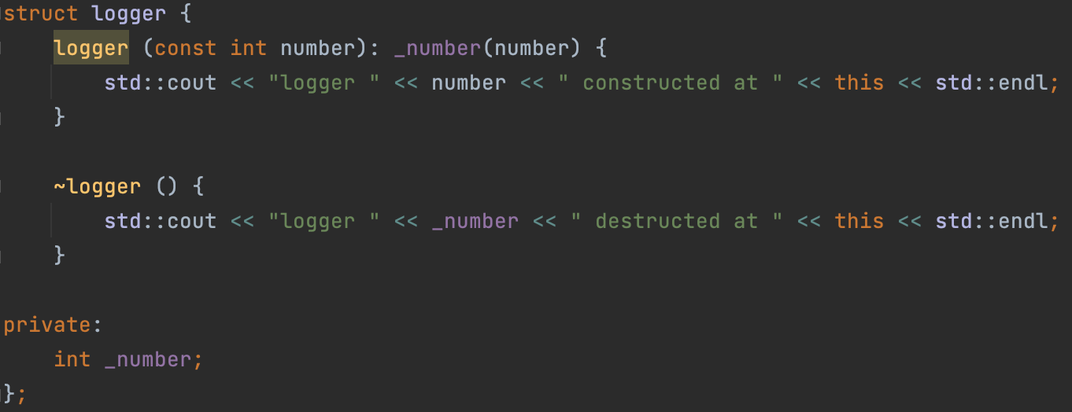
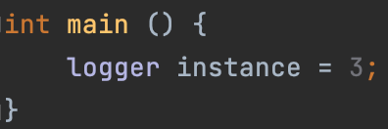
Explicit keyword
Let's take another look at the logger class:
As you can see, it has a constructor from one int argument.
The following code is allowed to compile, which is a problem (it can be confusing in some cases!)

Slide 36
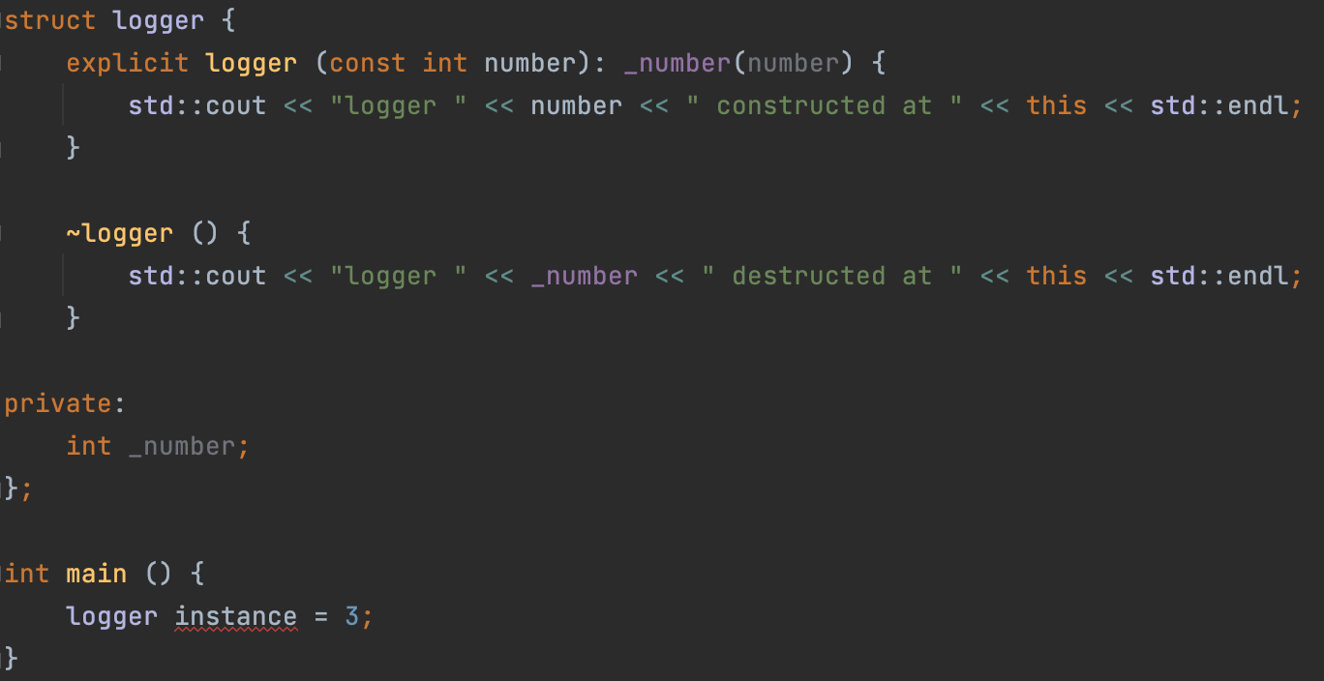
Explicit keyword
But if we declare a constructor as explicit, it won’t work anymore.
Thus, the explicit construct cannot be used for implicit conversions.

Slide 37
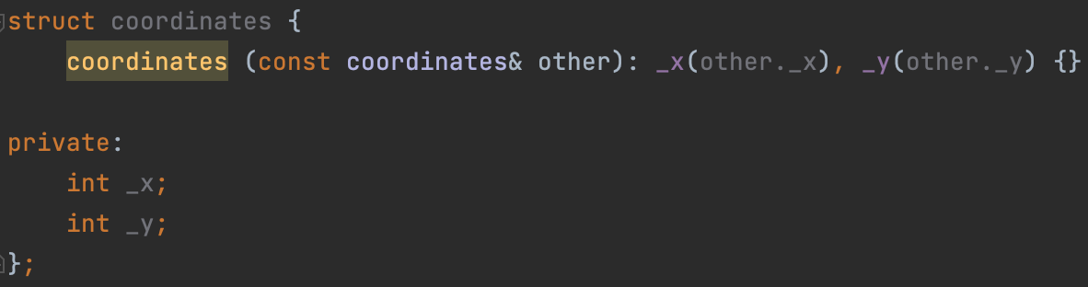
Copy constructor
A copy constructor of class T is a non-template constructor whose first parameter is T&‍, const T&‍, and either there are no other parameters, or the rest of the parameters all have default values.
The purpose of the copy constructor is to construct a new object based on the passed one.
At its core, copy-constructor should not modify the object passed to it (although the C++ language standard does not prohibit it). Therefore, we will not use the version in which we receive the object through a non-const reference.
Two options remain: T and const T&. But what's the difference? In the second case, no extra copy is created!
Notes:
In the second case, no extra copy is created! – прояснить этот моментик

Slide 38
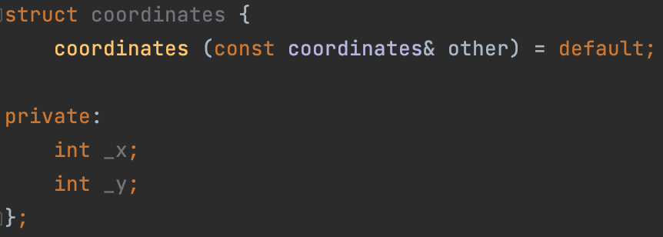
Implicitly declared and defined copy constructor
Implicitly declared copy constructor:
If no user-defined copy constructors are provided for a class type (struct, class, or union), the compiler will always declare a copy constructor as a non-explicit public member of its class.
Deleted implicitly declared default constructor:
The implicitly-declared or defaulted copy constructor for class T is defined as deleted if any of the following conditions are true:
T has non-static data members that cannot be copied (have deleted, inaccessible, or ambiguous copy constructors);
Implicitly defined copy constructor
If the implicitly-declared copy constructor is not deleted, it is defined (that is, a function body is generated and compiled) by the compiler. The constructor performs full member-wise copy of non-static members, in their initialization order.

Slide 39
Rule of three
As you can see, there are a lot of rules for implicit generation of default constructor, copy constructor and destructor (and I didn't even show you half of that!). Therefore, I propose to remember the following rule, following which you will never make the mistake when thinking about whether to define a certain constructor or destructor for you or not.
Rule of 3: If a class requires a user-defined destructor, a user-defined copy constructor, or a user-defined copy assignment operator, it almost certainly requires all three.
We haven't discussed the copy assignment operator yet, but don't worry, we will discuss it in the next lecture, in which we will talk about redefining operators in classes.

Slide 40
RAII
Resource acquisition is initialization (RAII) is a programming idiom used in several object-oriented, statically-typed programming languages to describe a particular language behaviour. In RAII, holding a resource is a class invariant, and is tied to object lifetime: resource allocation (or acquisition) is done during object creation (specifically initialization), by the constructor, while resource deallocation (release) is done during object destruction (specifically finalization), by the destructor. In other words, resource acquisition must succeed for initialization to succeed. Thus the resource is guaranteed to be held between when initialization finishes and finalization starts (holding the resources is a class invariant), and to be held only when the object is alive. Thus if there are no object leaks, there are no resource leaks.
RAII is associated most prominently with C++ where it originated, but also D, Ada, Vala, and Rust. Other names for this idiom include Constructor Acquires, Destructor Releases (CADRe). RAII ties resources to object lifetime, which may not coincide with entry and exit of a scope.

Slide 41
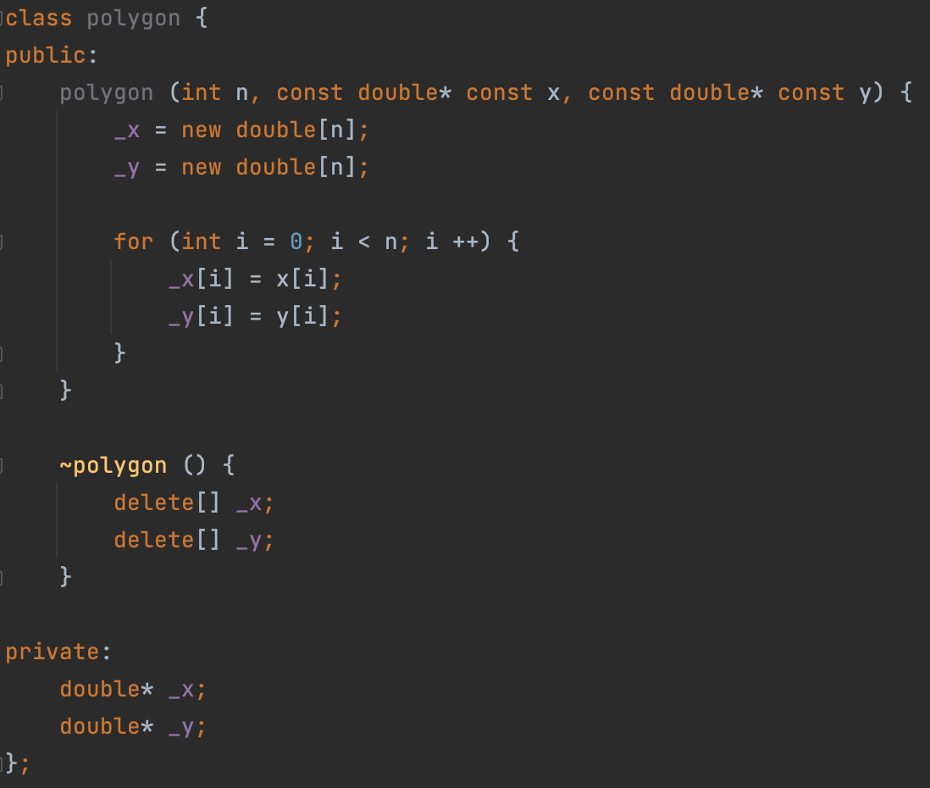
RAII, example
Let's create a polygon class that will take coordinates in the form of two arrays x and y, and store them inside itself

Slide 42
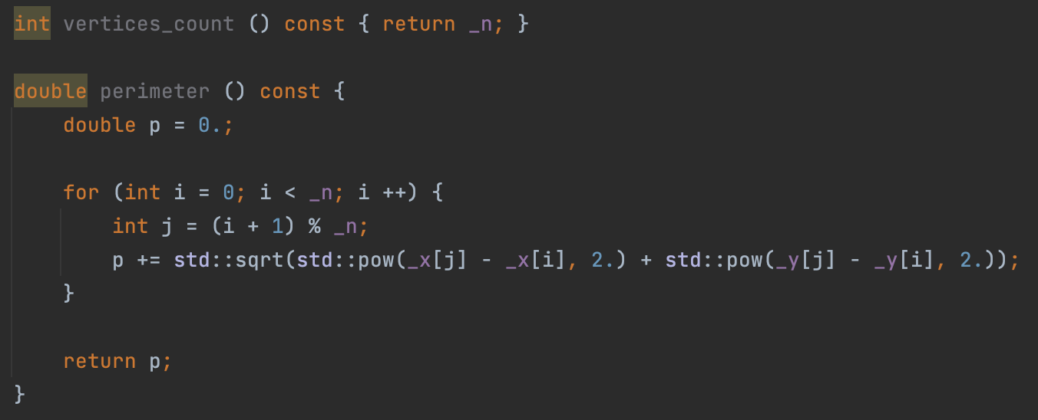
RAII, example
Let's add a couple of useful methods

Slide 43
RAII, example
Using defaulted copy constructor will not work in this case, because we need a "deep copy" of the object (instance).
But anyway, in order not to rewrite the main constructor code, let's use the delegate-constructor

Slide 44


Allocating class instances on heap
Class instances can be allocated to the heap, as is the case with primitive types such as int:
But in this case, if we refer to a pointer on an instance, we have to use the operator -> instead of the operator .

Slide 45
Allocating class instances on heap
Let’s rewrite our entire polygon class so that it works with the coordinates class.
Full code can be found here.

Slide 46

Copy assignment operator
The copy assignment operator allows you to change the content of an already created object by copying the state of another object into it. The difference between the copy assignment operator and the copy constructor is that the copy assignment operator does NOT create a new object, but operates with existing ones.
Defining custom copy assignment operator:
Defining your own copy assignment operator for a class is very similar to defining a method.

Slide 47
Operator= return type
Why operator= does not return void
Let's remember the very first lectures, namely, the lecture about expressions. In it, I talked about expressions of this type:
x = y = z;
For such expressions to work correctly, the result of the expression y = z (which is getting calculated first, of course) must be the value of the object obtained after the assignment.
Why operator= returns a reference
Because in some cases, we need a reference to the object we just assigned to!
(x = y) = z;
In this example, there will be two calls to the copy assignment operator:
x = y, and then x = z

Slide 48
Rule of three, recap
Rule of 3: If a class requires a user-defined destructor, a user-defined copy constructor, or a user-defined copy assignment operator, it almost certainly requires all three.

Slide 49
STL Containers, first cursory overview
Let's look at a few examples of classes built into the standard library that will be useful during homework and exam contest: std::vector, std::array
std::array and std::vector are called containers, they provide some storage for collection (sequence) of objects, or primitives. There are a lot of containers, we will all look at all of them in detail in the second semester.

Slide 50

std::array: constructor
std::array is a fixed, non-expandable array. Roughly speaking, it is analogous to C-style-array (for example, int[]). Array owns elements like any container, so we can say that it is using the RAII idiom.
To create an array, you need:
To include <array> header
To pass the type of the array element and the number of elements in the array in triangle brackets (this is called template parameters, we'll talk about how it works later)
To call constructor from std::initializer_list

Slide 51

std::array: copy constructor and copy assignment operator
Naturally, the array supports both the copy constructor and the copy assignment operator
Of course, the types and sizes of the arrays must match for copying to be possible!

Slide 52

std::array: operator[]
You can use the operator[] to access array elements, just like a regular C-style array. This works because the operator[] is defined for the std::array class. Actually, it’s better to say that it’s REdefined.
The operator[] returns a reference to the i-th element of the array, so we can assign to this reference to change the value of the i-th element, meaning, that the operator[] provides both read access and write access to a specific element. This concept is called an accessor.

Slide 53

std::array: const qualifier
If we add a const qualifier to the array, we disallow any modifying operations on it:
in a const-qualified array, you cannot copy to it, using copy assignment operator and modify its elements through the operator[].
This is achieved by the fact that the operator[] has two versions: one for a non-const-qualified array, and the other for a const-qualified array.

Slide 54

std::array: another useful methods
size() returns the amount of elements in the array
front() is identical to the array[0]
back() is identical to the array[array.size() - 1]
empty() returns true if array is empty, false otherwise
operator== compares two arrays
size() method returns size_t type, which is an unsigned variable, size of which is not less than 2 bytes.
size_t can store the maximum size of a theoretically possible object of any type (including array).

Slide 55

std::array implementation
We will talk about std::vector next time, and today we will implement the non-template version of std::array
Key points:
allocate data in constructor, deallocate in destructor (RAII)
operator= implementation: don’t forget to clear the state before copying
operator= implementation: comparison with &other to avoid copying the object to itself
two differently qualified operators[]: getter and setter
size() method is a getter, it provides only read access to a certain property of an object, thus, it’s const qualified

Slide 56

Operator redefinition, practice
C++ allows you to redefine many operators in classes. Let's take a look at this using the vector class as an example (DO NOT Confuse with std::vector!), Which stores the value of a 3D vector in space. Let's implement most of the useful operators in it.

Slide 57

3D Vector: base
First of all, let’s create a class itself. I’ll won’t use encapsulation in order to hide fields x, y and z, because it’s practically useless in this particular case.
Then, I’ll define:
Constructor from three doubles, which will initialize x, y and z variables with values
Default constructor, which will initialize coordinates with zeros by calling delegate constructor from three doubles.
Default copy constructor
Default copy assignment operator
Default destructor

Slide 58


3D Vector: compound assignment operators
First 3D-vector-specific operator, which we’ll redefine will be the compound assignment operator +=
Operator += should not modify its second argument (it should receive it by const reference)
Operator += should be defined in-class and be non-const
Operator += should return ref to the current object similarly to the copy assignment operator
Signature of every the compound assignment operators is similar to copy assignment operator. Implementation is obvious in this case.

Slide 59


3D Vector: compound assignment operators
Implementation of the operator –= is very similar.
However, implementation of the operator *= is a little more complicated, just because cross product multiplication is a complicated arithmetic operation.

Slide 60

3D Vector: compound assignment operators
Great, we learned how to multiply a vector by a vector. But what if we want to multiply a vector by a number? Let's define a second method * = that will take a number. One definition rule is not violated in this case, because the signatures are different.

Slide 61

3D Vector: compound assignment operators
Summarizing up the compound assignment operators redefinition topic, I want to say that the examples I have shown is applicable to other compound assignment operators. Every other compound assignement operator can be redefined simply. Here in the table I gave the signatures of these operators:

Slide 62

3D Vector: binary arithmetic operators
Sometimes, we don't want to change the state of the original object when calculating the sum. In this case, we want to create a new object that will be the sum of the two original ones.
There are binary arithmetic operators for this:
So, binary arithmetic operators should receive two objects by const references and create new object, which stores the sum.
Since the context of the binary operators is not limited to one object, I recommend implementing them out-of-class, this is the way I will show you.

Slide 63

3D Vector: binary arithmetic operators
In the screenshot on the right, I have given a common implementation of the binary operator +. Everything seems to be fine, however, let's note one subtlety: we have defined the logic for summing two vectors again! Remember, we have already done this in the case of the operator +=! It turns out that in this case we accidently utilized copypasting…
In the vector example, it is not clear why this is bad. But, believe me, in our course in the future we will consider more complex classes that have more sophisticated methods of addition. We would not like to use copypaste in this case. Instead of that, why not rely on the operator +=, which we have already implemented?

Slide 64

3D Vector: binary arithmetic operators
Above is the correctly defined operator += for the vector class. It consists of three parts:
Making a copy of the first vector
Calling operator += on this copy
Returning the resulting value from a function
This solution can even be written in one line using the concept of temporary object. Let's look at it in order to optimize our solution.

Slide 65



Temporary object
C ++ allows us to create a temporary unnamed object by calling its constructor:
The temporary object can be used both to the left of the assignment operator (lvalue) and to the right (rvalue):

Slide 66


3D Vector: binary arithmetic operators
So let's use the concept of a temporary object to implement the binary operator +:
The advantage of this implementation is its versatility. It will almost always be convenient to define the binary operator + exactly as shown above.
Operator – and operator * can be implemented similarly:

Slide 67
3D Vector: binary arithmetic operators
Let’s support the operator * in case of:
multiplication vector by a vector
multiplication vector by a number
multiplication number by a vector

Slide 68


3D Vector: unary arithmetic operators
We may want to get the reflected vector, relative to the origin. In the case of numbers, we use the unary operator – for this task.
Unary arithmetic operators doesn’t change the object they are applied too. Instead, they create a copy of the object. Usually they are defined in-class and, thus, const-qualified:

Slide 69

3D Vector: unary arithmetic operators
In addition to the unary operator –, there is also the unary operator +. It might seem like such operator doesn't make sense, because it just copies the value of the vector without changing it. Unfortunately, I cannot yet demonstrate a useful example using this operator, so for now, let's just define it:

Slide 70


3D Vector: problem with binary and unary arithmetic operators
Consider the following example:
On the second line in the main function, we are assigning to a temporary object. Obviously, such an operation is meaningless, because the temporary object will not be available in the future.
This is allowed because the result of a unary operator – is an lvalue (a value that can be used as the left operand of an assignment operator) in our case.
By the way, in the case of int, this idea will not work.

Slide 71


3D Vector: problem with binary and unary arithmetic operators
So how do we fix the problem? The obvious solution is to return an rvalue instead of an lvalue from the operator –. To do this, just add a const-qualifier to the return type of the operator –.
WARNING: do not confuse const-qualifier applied to return type and const-qualifier of a method!
Well, now the same line of code will not work (which is great) and CE will appear:

Slide 72


3D Vector: problem with binary and unary arithmetic operators
Let's update the return type in all places where a similar problem might arise.
Note: CLion marked the return type in yellow because this solution is not entirely correct. We'll dive into details later when we will be discussing the so-called reference qualifiers. Later, we will come up with a correct solution of the problem using them. The current solution should be taken as temporary.

Slide 73

3D Vector: arithmetic operators
Summarizing up the arithmetic operators redefinition topic, I want to show you the table below:
Operators operator / and operator % can be redefined similarly to operators operator +, operator – and operator *.
Just don’t forget that every binary arithmetic operator should be implemented via a corresponding compound assignment operator.

Slide 74


3D Vector: comparison operators
Let's define two helper operators that allow us to compare two vectors with each other: the operator == and the operator !=. Since the coordinates of the vector are real numbers, we will compare them using the algorithm for comparing real numbers.
Please pay attention to the implementation of the operator !=.
It is very important that it refers to the operator ==. Thus, we avoid the tautology (just like with the example about operator += and operator +)

Slide 75

3D Vector: comparison operators
The remaining four comparison operators can also be redefined, however there is a trick that we will discuss later when we’ll redefine these operators.
Unfortunately, in the case of vector, we can’t define these four operators, because the ordering relation over points in the ${\text{R}}^{3}$ space does not exist.

Slide 76

3D Vector: I/O operators
If we want our object to be scannable from the terminal and printable into it, then we have to redefine two binary bitwise shift operators of a special form (accepting std::istream and std::ostream, representing input and output streams, respectively).
Both of these operators must return the reference to the stream they received as an argument. This is necessary in order to support the chain call of operator >> and operator <<

Slide 77
3D Vector: full code
Full code of the vector class can be found here.

Slide 78
Splitting the solution into multiple files
C++ has a common project structure. For now, I'll just teach you how to split your solution into several files and organize the structure correctly without going into details.
Let's take the vector class we wrote in the previous lesson.
So far, our entire solution is written in one file - main.cpp. So far, this does not cause problems, since there is little code, but on an industrial scale, the amount of code in the repository can be several million lines of code, so it is important to be able to split the solution into separate components, and the files corresponding to them.
For example, our code now has three parts:
The double_cmp function, which compares doubles, separate from the vector class
The vector class, which is a vector in three-dimensional space, and the operators redefined to work with it
The main function

Slide 79

Splitting the solution into multiple files
Each component, which is, for example, a class (just like in our case) must have two files: .h and .cpp
In the .h files, we declare functions, classes and their methods, but we don't define them!
In the .cpp files, we define functions and methods of the class
Both files must have the same name, but have different extensions. The name of the files must coincide with the name of the class, if the component is a class, or, otherwise, when the component contains several classes, generalize their essence.
For example, our project can be divided into 2 components:
vector: will contain class vector
double_cmp: will contain function double_cmp
The project structure is shown on the right:

Slide 80


Splitting the solution into multiple files
After adding the files to the project, you will also have to add the file names to CMakeLists.txt
Also, if you are working in CLion, after changing CMakeLists, you will be prompted to reload project. Obviously, this must be done in order for the compiler to update the project structure.

Slide 81

Splitting the solution into multiple files
In double_cmp.h file, we declare a function double_cmp.
Note that the arguments in the function declaration are not const-qualified, because const-qualifier is pointless for unmodified type in declarations. In other words, const qualifier of unmodified type (non-pointer, non-array and non-reference type) is only valid in definitions.
EXAMPLES_DOUBLE_CMP_H – is a “full name” of the file, which compiler will use in order to avoid including one file multiple times.
This name should be unique for every header file in your project.
Usually, this name is built according to the following principle: {project_name}_{path_to_file}.
For example, if my project is called geometry, and the file path is lib/figures/polygon.h, then define should be: GEOMETRY_LIB_FIGURES_POLYGON_H

Slide 82

Splitting the solution into multiple files
In double_cmp.cpp file, we define a function double_cmp.
In the definition we add const-qualifier, but we do not assign the default value for the eps argument (default value should be assigned in the declaration)
It’s mandatory to include the corresponding header file in the source file.
But the opposite should never be done! In other words, never do an include of a .cpp file in your code!

Slide 83

Splitting the solution into multiple files
In the vector.h file, we only provide function declarations, even if they are methods (defined inside the class)!
Also, don’t forget about #define
Once again, const qualifiers are absent in functions signatures for the arguments, provided by values

Slide 84

Splitting the solution into multiple files
In vector.cpp we define methods and functions which are declared in vector.h
Don't forget #include "vector.h”
Using the operator ::, we can define methods
For this, before the method name, you need to add the class name and the operator ::
In the case of non-method functions, we don't need to do this!
For example, if the class is called my_class, and the method in it is my_method, then its definition might look like this: void my_class::my_method () {}

Slide 85


Splitting the solution into multiple files
Here’s some more definitions of several methods:

Slide 86

Splitting the solution into multiple files
And finally, the definition of ordinary functions.
By the way, note that in order to use the double_cmp function, we included file double_cmp.h in the vector.cpp file (but not in vector.h!)

Slide 87

Splitting the solution into multiple files
To use our vector class in the main function, you need to include the corresponding header in the main.cpp file.

Slide 88
Splitting the solution into multiple files
Links to the full code:
CMakeLists.txt
double_cmp.h
double_cmp.cpp
vector.h
vector.cpp
main.cpp

Slide 89

std::vector: constructor from initializer list
std::vector is a dynamic (non-fixed), expandable array. Vector owns elements like any container, so we can say that it is using the RAII idiom.
To create a vector, you need:
To include <vector> header
To pass the type of the vector element in the vector in triangle brackets (as a template parameter)
To call constructor from std::initializer_list

Slide 90
std::vector: other methods, similar to std::array
Naturally, the vector supports both the copy constructor and the copy assignment operator. They work the same way as with std::array. Of course, the types of the vectors must match for copying to be possible!
The std::vector class has the operator[] overloaded in the same way as in the case of std::array. Similar to std::array, it has 2 versions: const and non-const.
Other methods that were present in std::array too
size() returns the amount of elements in the vector
front() is identical to the vec[0]
back() is identical to the vec[vec.size() - 1]
empty() returns true if array is empty, false otherwise
operator== compares two vectors

Slide 91

std::vector: methods, changing its size:
push_back() appends element to the end
pop_back() removes the last element of the vector
resize() resizes the vector, addining new elements if new size is greater than the old size. Elements in this case are initialized with value, provided in the second argument. Or, if the new size is less than the old size, removes a certain number of elements.

Slide 92

std::vector: constructor from size and value
Vector has a useful constructor that std::array lacks. It allows you to do many useful things, which we will analize in examples today.
This constructor takes 2 arguments, the same as the resize method: the size and the value that the vector elements will be initialized to.

Slide 93
std::array VS std::vector
std::array
non-expandable
size should be fixed and known at compilation stage
uses stack memory to allocate elements
std::vector
expandable
size can be dynamic and may change during the vector’s lifetime
uses dynamic (heap) memory to allocate elements
Conclusion: std::array should be used when the size of the array is known at compile time. In other cases, you should use the vector

Slide 94


range-based for loop
If your task is to iterate over an array, or a vector, and do something with each element (for example, display each element on the screen), then you can use the following code:
However, to solve such a problem, there is a special kind of for loop that allows you to do the same without writing extra code and creating an extra variable i:
In this case, the body of the loop will be called sequentially for each element, while the value of each element will be passed as a constant through the element variable.

Slide 95


range-based for loop
But what if, for example, we want to input each element of a vector? Let's try using a code like this:
Unfortunately, it’s not hard to see that the code doesn’t work. But why? The fact is that the variable element is initialized by value (although not const-qualified), and does not contain a reference to the actual element of the array, because it is a copy of it!

Slide 96


range-based for loop
To fix the problem, simply declare the element variable as a reference:
And now the code is working fine

Slide 97


range-based for loop
If you want to work with an array / vector of some objects without changing the array / vector itself (reading, not writing data to the array / vector), then I recommend using a const reference to avoid unnecessary copying of objects (after all, objects can be large, unnecessary copies should be avoided)
The copies made during the initialization of the vector are marked in blue (copies made during construction from the std::initializer_list are usefull, because the objects must somehow be moved from it to the vector)
The optional copies that were made during the range-based for loop are marked with the red color.

Slide 98


range-based for loop
But if we add a reference, then everything will be fine:
← Only useful copies here

Slide 99

range-based for loop
Quick definition: variable element is called an iterator of the range-based for loop:
Summary
Array of primitive types:
Want to only read each element of the array: initialize iterator by value (or const value)
Want to write to / modify each element of the array: initialize iterator by non-const reference
Array of object types:
Want to only read each element of the array: initialize iterator by const reference
Want to write to / modify each element of the array: initialize iterator by non-const reference

Slide 100


std::string
The C++ strings library includes support of dynamic strings.
The class std::string generalizes how sequences of characters are manipulated and stored. String creation, manipulation, and destruction are all handled by a convenient set of class methods and related functions.
String can be easily constructed from string literal.
Operator<< is supported

Slide 101





std::string
Operator+ concatenates two strings:
Operator>> is also supported:
Operator+= appends to a string:
Method size returns amount of chars in string:
int <-> string conversions:

Slide 102

std::stringstream
Definition:
Output stream (remember std::ostream) is an object into which you can put data in streaming mode, i.e., sequentially and piece by piece. For example, std::cout is an output stream, because we can transfer data to it sequentially and do it as many times as we like.
Definition:
Input stream (std::istream) is defined analogously as a stream that allows data to be read in a stream mode.
The std::stringstream class is a special case of the output stream. Its difference from std::cout is in that it does not print data to the screen, but to a string buffer that it stores inside itself.
After you've finished printing data to stringstream instance, you can get the buffer as a string by calling the .str() method.
The practical use of a stringstream is that it allows you to convert arbitrary objects to strings as long as these objects support the operator >>, receiving std::ostream (std::cout, or std::stringstream, for example)

Slide 103

enums
An enumeration is a distinct type whose value is restricted to a range of values (see below for details), which may include several explicitly named constants ("enumerators"). The values of the constants are values of an integral type known as the underlying type of the enumeration.
Enum should be used as a label when you have several alternatives and need to specify which one you want to use.
Enum is very easy to use with switch / case

Slide 104
Practice
Problem 1 [Solution]
You are given the coordinates of a bishop on a chessboard. Print out the coordinates of each cell to which you can make a move.
Problem 2 [Solution] You are given two numbers n, m, and a matrix of size n by m. Transpose it and print it out.
Problem 3 [Solution]
You are given a string. You should check if it is a palindrome, or not.

Slide 105

Practice
Problem 4 [Solution]
Write a hexagonal_grid_traveler, which represents the traveller on hexagonal grid.
Public enum direction (should be inside the class!), which should have six enumerators: e_up, e_up_right, e_down_right, e_down, e_down_left, e_up_left
Default constructor, copy constructor, copy assignment operator, destructor
Public non-const method move, which receives enumerator of the enum direction by a value and returns void. Moves the traveller in the provided direction.
Public const method (getter) get_coordinates, which should return current coordinates of the traveller in the field

Slide 106


Class bigint
Problem: calculate n!
For large n (for example, n = 100), the number n! can’t be stored in any integer number type in C++, so in order to properly solve this problem, we should implement a class, which will work just like int (interface-wise), but will support working with the numbers of unlimited size.
To support long multiplication, for example, we can use the algorithm which all of us have already learnt at school:

Slide 107

Class bigint

Slide 108

Class bigint
Member fields
Idea: let’s store number as a reversed sequence of its digits
Idea 2: let’s store a special bool-flag, which will indicate if the number is negative or not

Slide 109

Class bigint
Constructors, rule of three
Constructor from int: since the constructor is not defined as explicit, we can initialize bigint just like int (look at the one and only line in the main function)
Default constructor: should initialize bigint with 0
Copy constructor: should be defaulted
Destructor: should be defaulted
Copy assignment: operator should be defaulted

Slide 110

Class bigint
Arithmetic operations
As in the case of vector (3D), in order to correctly define arithmetic operations, you first need to define compound assignment operators, and then binary operators (don’t forget to const qualify the return value of binary operators).
Algorithm-wise, the operations of long addition, subtraction and multiplication were learned in school, so I will not repeat them again.
Unary + and – will be very easy to implement due to the presence of the _negative variable.
By the way, in order to support expressions like x + 1 (where x is a bigint) you don’t even have to redefine the operator+ to receive int as an rhs, because in this case 1 will be implicitly converted to a bigint object using our non-explicit (aka implicit) constructor!

Slide 111

Class bigint
Arithmetic operations
Prefix increment and decrement operators should behave the same as operators += and -= respectively when the provided rhs is equal to one:
++ x ⬄ x += 1
-- x ⬄ x -= 1
So, they can be easily implemented:

Slide 112

Class bigint
Arithmetic operations
The difference between postfix operators and prefix operators is that they create a copy of the object before calling the compound assignment operator and return it by value.
To overload postfix operator, you have to use the strange, but the only permitted signature:
Postfix operators should receive unnamed and unused variable of type int.
This is a trick introduced by the creators of the language to make prefix and postfix operators have different signatures so they could be overloaded at the same time without a compilation error.
Similar to the arithmetic binary and unary operators, I add a const qualifier to the return type to make it an rvalue

Slide 113

Class bigint
Comparison operators
I recommend you to implement the operator< and the operator== by yourself, using the trivial algorithms of numbers comparison.
Then, the rest operators can be easily implemented:

Slide 114

Class bigint
Redefining the casting operators
Sometimes it's useful to be able to convert an int to a bool (remember the first lectures in which I told you that any nonzero number converts to true, and zero to false). For instance:
To support the same behaviour for bigint, we have to redefine the so-called operator bool

Slide 115


Class bigint
Redefining the casting operators
Method operator bool returns true if number is not equal to 0, false otherwise
Explicit keyword is applied to disallow unintentional conversions (just like in the case of constructor)
Redefining operator bool allows you to apply C-style cast and static cast of type bigint → bool
Besides operator bool, you can overload the conversion operator to support any other type

Slide 116

Class bigint
Redefining the operators << and >>, method to_string
The idea of ​​overloading the operator >> and the operator << has already been discussed using the vector (3D) class as an example. In the case of bigint, this can be done by analogy. The only thing, to overload the operator >> (input), you have to read data into an std::string instance, and then parse it manually.
Method to_string can be implemented easily after you have already implemented the operator <<. The trick is to use the std::stringstream instance, discussed before:

Slide 117


Some anti-patterns
friend keyword: The friend declaration appears in a class body and grants a function or another class access to private and protected members of the class where the friend declaration appears.
You shouldn't use the friend keyword in a well-written code, because it goes against the OOP design principle that respects encapsulation (the word friend breaks encapsulation!)
Important note: in the bigint class you might want to declare the operators <<, >>, == and < as friends. In this case (one of the very few), using the friend keyword makes sense and allows you to design your code better.

Slide 118



Some anti-patterns
mutable specifier: permits modification of the class member declared mutable even if the containing object is declared const.
Another example:
You shouldn't use the mutable keyword in well-written code, because it goes against the OOP design principle that respects const-correctness (the word mutable breaks const-correctness!)

Slide 119
Namespaces
Namespaces provide a method for preventing name conflicts in large projects.
Symbols declared inside a namespace block are placed in a named scope that prevents them from being mistaken for identically-named symbols in other scopes.
Multiple namespace blocks with the same name are allowed. All declarations within those blocks are declared in the named scope.
Common examples of built-in standard library namespaces are:
std
std::chrono
std::experimental
std::pmr
std::views
…

Slide 120


Namespaces

Slide 121


Namespaces
Keyword using
In order to aboid specifying certain namespace name too, you can use the using keyword:

Slide 122


Namespaces
Keyword using
You can use all the objects in the namespace with the keyword using

Slide 123

Some anti-patterns
using namespace std
“Problem”: programs often need to use std objects. However, this leads to writing std:: too often. If that doesn't bother you (like me and most of the pros in C++) then it's okay, you can skip this slide. However, if you are worried about writing std:: too often, then you might want to do the following: using namespace std
Let me try to explain why this is bad.

Slide 124



Some anti-patterns
using namespace std
When you do using namespace std, you include absolutely all std objects in your program. As a result, if you unintentionally name some variable or function with the name of an object already existing in std, CE, or, even worse, UB can occur:

Slide 125

Some anti-patterns
using namespace std
Solutions:
[Approved by me] Use std:: – syntax, and don't worry about often writing it
If, for example, you need to use std::vector often, then do using std::vector;. This will only include the vector in the global namespace, instead of all std–objects (as it was in the case with using namespace std). But again, you cannot define another vector class. That is, even this method has certain limitations, so personally I do not see the point in it.

Slide 126
Lecture 2
Classes & Structures
C++ Programming
Konstantin Leladze
FCS HSE 2022

